Slide 1

Self-Balancing Autonomous Unicycle
Client: Andy Chang (National Instruments)
Supervisor: Dr. Robert Throne
Leader: Kevin Collins
Members: Spencer Carver
Ander Solorzano
Ruffin White-Magner
Team
G

Slide 2
Project Overview
Project Plan
Current Status
Control Strategies
Modeling
Conclusion
Build a self-balancing robotic unicycle for National Instruments (NI), using as many NI components as possible
Notes:
Kevin
We have been asked by national instruments to design and build a self balancing unicycle robot to showcase NI’s newest robotics toolkit.
National Instruments has developed a full real time controlling suite to be all encompassing with the LabVIEW Robotics toolkit and their Real-Time controllers, specifically to us the compact Rio, or cRIO.

Slide 3
Problem Description
Current Status
Control Strategies
Modeling
Conclusion
Project Plan - Overview
Approach the build in stages:
STAGE 1: Robotics Environment Simulator
STAGE 2: NI CompactRIO Real-Time Controller
STAGE 3: State Space Control Design
STAGE 4: Robot Construction
STAGE 5: Integration & Debugging
Notes:
Kevin
We will start by modeling the system in the labview robotics environment simulator, and develop our control algorithms using the simulator. Then, once we are confident in our control algorithms, we will use the cRIO to control our physical robot.

Slide 4
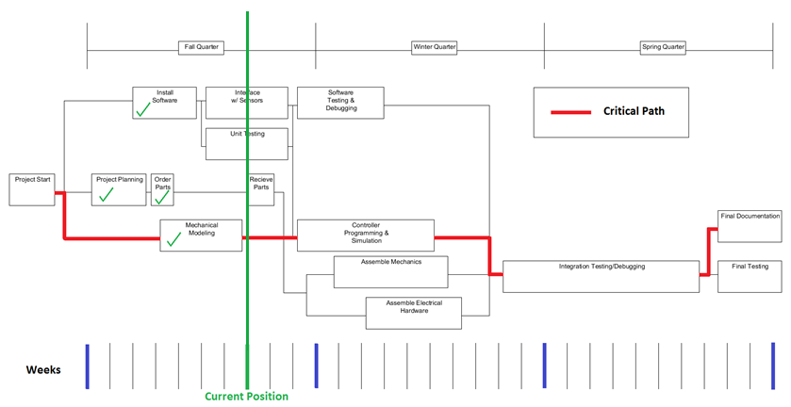
Problem Description
Current Status
Control Strategies
Modeling
Conclusion
Project Plan – Planning Flow Chart
Notes:
Kevin
Here you can see our project plan. An important thing to note is how long we are leaving purely for debugging. We have a good understanding of the problem, and are confident that our solution will work, but one thing that we determined very early was that we would like to have a working version of it before the end of winter quarter to leave plenty of time to tune our control algorithm.

Slide 5
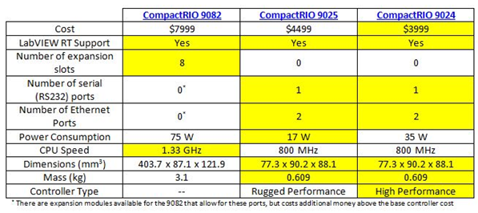
Problem Description
Current Status
Control Strategies
Modeling
Conclusion
Project Plan – Decision Matrices: Overview
Notes:
Spencer

Slide 6
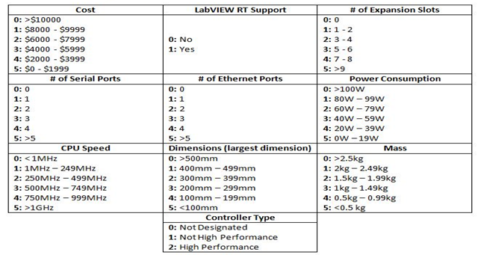
Problem Description
Current Status
Control Strategies
Modeling
Conclusion
Project Plan – Decision Matrices: Weights
Notes:
Spencer

Slide 7
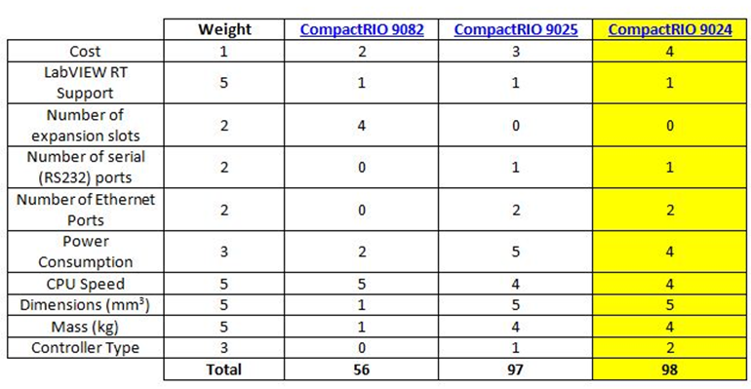
Problem Description
Current Status
Control Strategies
Modeling
Conclusion
Project Plan – Decision Matrices: Evaluation
Notes:
Spencer

Slide 8
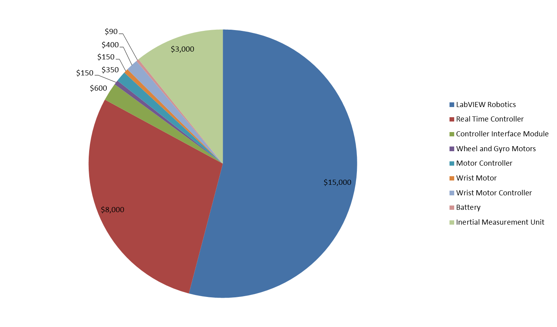
Problem Description
Current Status
Control Strategies
Modeling
Conclusion
Project Plan – Budget
Total Cost: $27,740
Notes:
Spencer

Slide 9
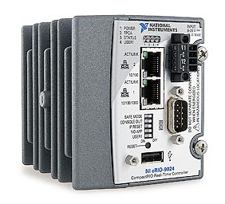
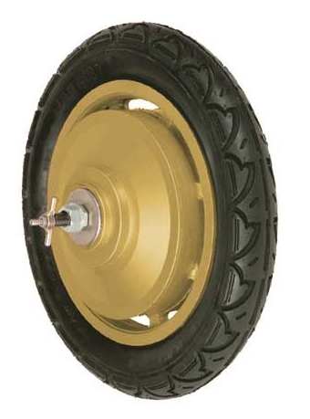
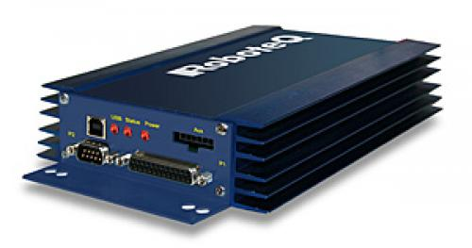
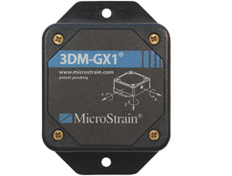
Problem Description
Current Status
Control Strategies
Modeling
Conclusion
Project Plan – Critical Parts
CompactRIO Real-Time Controller
In-Hub Motors
Motor Controllers
Inertial Measurement Unit (IMU)
Notes:
Spencer

Slide 10
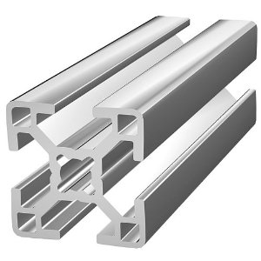
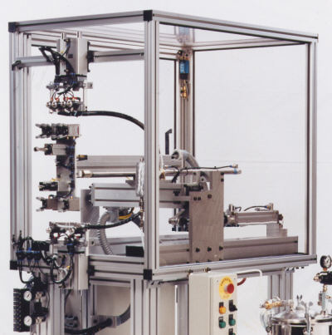
Problem Description
Current Status
Control Strategies
Modeling
Conclusion
Project Plan – Structural Components
Plan to use Aluminum Extrusion
The material is very easy to use, sturdy, and relatively inexpensive
Very adaptable for future changes and adjustments
Brackets will also be necessary to construct the frame
Notes:
Kevin
Once we have all of the electrical components, we will build

Slide 11
Problem Description
Project Plan
Control Strategies
Modeling
Conclusion
Current Status – Progress
According to our flow chart, the current tasks are:
Interface w/ Sensors
Unit Testing
Receive Parts
Our parts arrived just before fall break, and we are currently in the process of interfacing with them and testing with the systems we have been exploring
Notes:
Kevin

Slide 12
Problem Description
Project Plan
Control Strategies
Modeling
Conclusion
Current Status – Team Progress
Hours spent on project as of 10/15/2012: 165
Spencer Carver: 34
Kevin Collins: 40
Ander Solorzano: 37.5
Ruffin White-Magner: 53.5
Tasks Recently Completed:
Mechanical Model – Kevin Collins & Ruffin White-Magner
Receive Parts– Ander Solorzano
Tasks Currently In Progress:
Simulation – Kevin Collins & Ruffin White-Magner
Interface w/ Sensors – Spencer Carver, Ander Solorzano, & Ruffin White-Magner
Research Real-Time VIs – Spencer Carver & Ander Solorzano
Notes:
Ander

Slide 13
Problem Description
Project Plan
Current Status
Modeling
Conclusion
Control Strategy
Self Balancing Unicycle
Non-linear system
Feedback
Real-Time operation
Dynamically unstable
Discrete time
Autonomous
Controllable system
Notes:
Ander

Slide 14
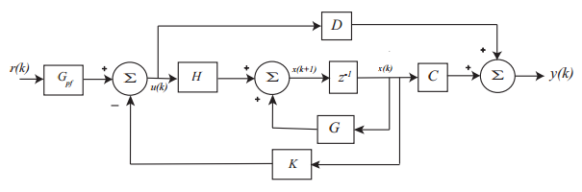


Problem Description
Project Plan
Current Status
Modeling
Conclusion
Control Strategies – Mathematical Model
Non-linear problem → Linearize → Use state variable description
Discrete time state variable feedback system
State Variable Equations
x(k) = state vector
u(k) = input vector to the plant
y(k) = output vector from the plant
G,H,C,D matrices are constant
K = feedback gain matrix
$$x\left(k+1\right)=G∗x\left(k\right)+H∗u\left(k\right)$$
$$y\left(k\right)=C∗x\left(k\right)+D∗u(k)$$
Notes:
Ander

Slide 15
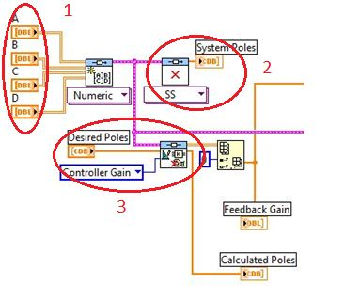
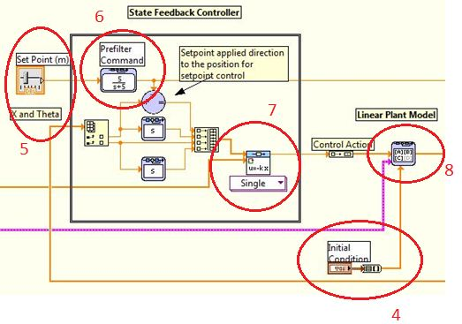
Problem Description
Project Plan
Current Status
Modeling
Conclusion
Control Strategies - LabVIEW
State Vectors A,B,C,D
Dynamic Analysis computes poles
Determines controller gain based on desired poles
Set initial conditions
Alter pole placement
Apply prefilter
Compute controller feedback output
Implement model in state-space form
Notes:
Ander

Slide 16
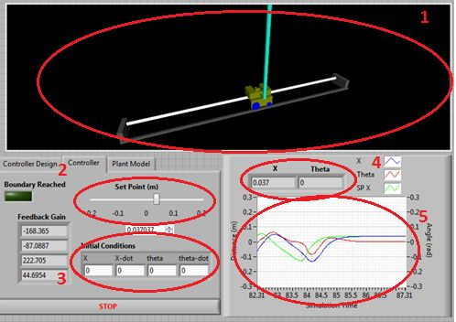
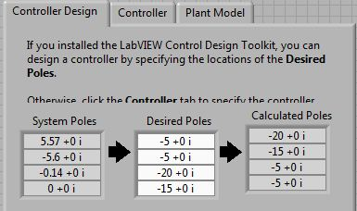
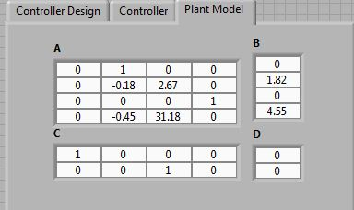
Problem Description
Project Plan
Current Status
Modeling
Conclusion
Control Strategies – LabVIEW Front Panel Example
System model
Alter system’s position
Set initial conditions
Position (x) and pole angle (Theta) real-time outputs
Plot of system output
Placing Poles in the system
Modify the plant model
Notes:
Ander

Slide 17
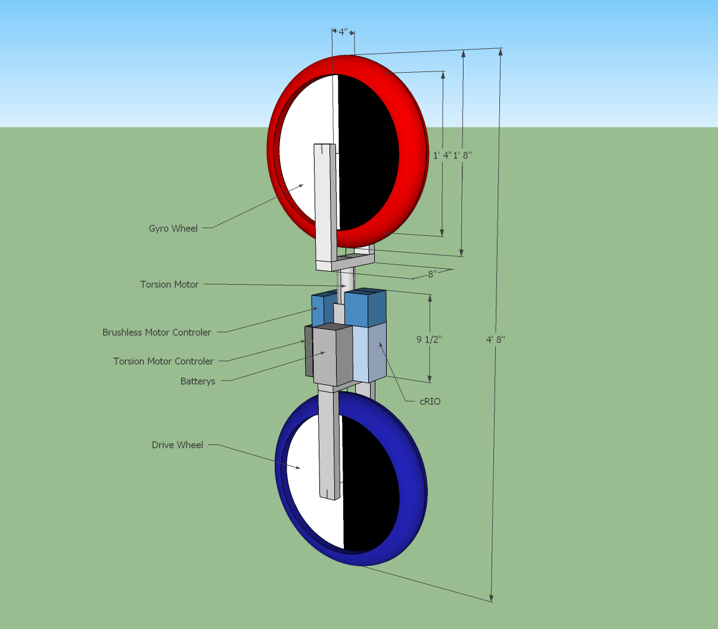
Problem Description
Project Plan
Current Status
Control Strategies
Conclusion
Modeling
Notes:
Ruffin

Slide 18
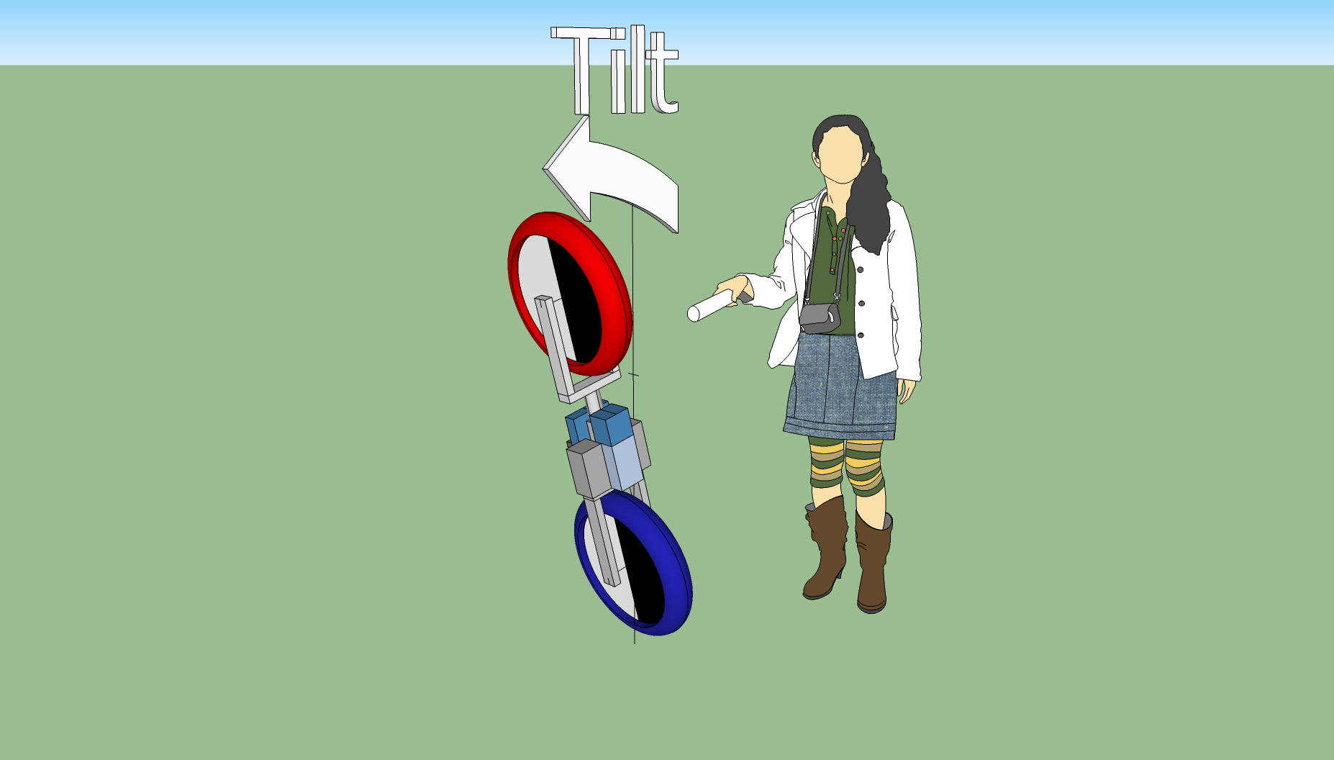
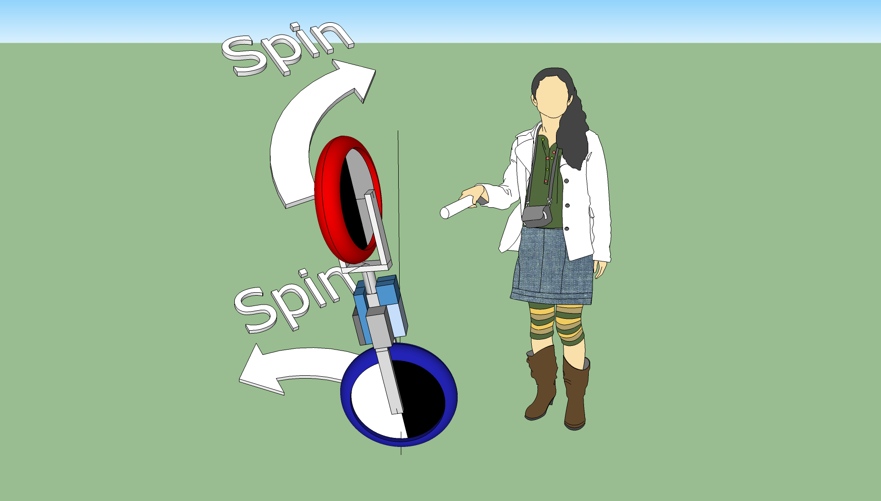
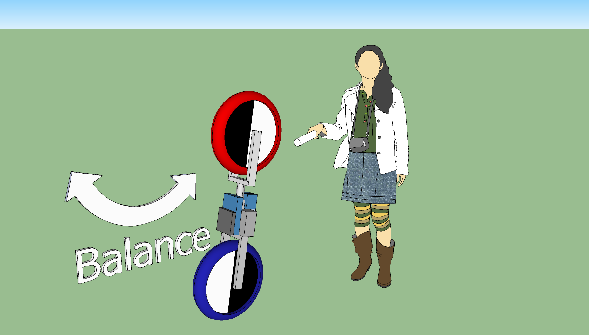
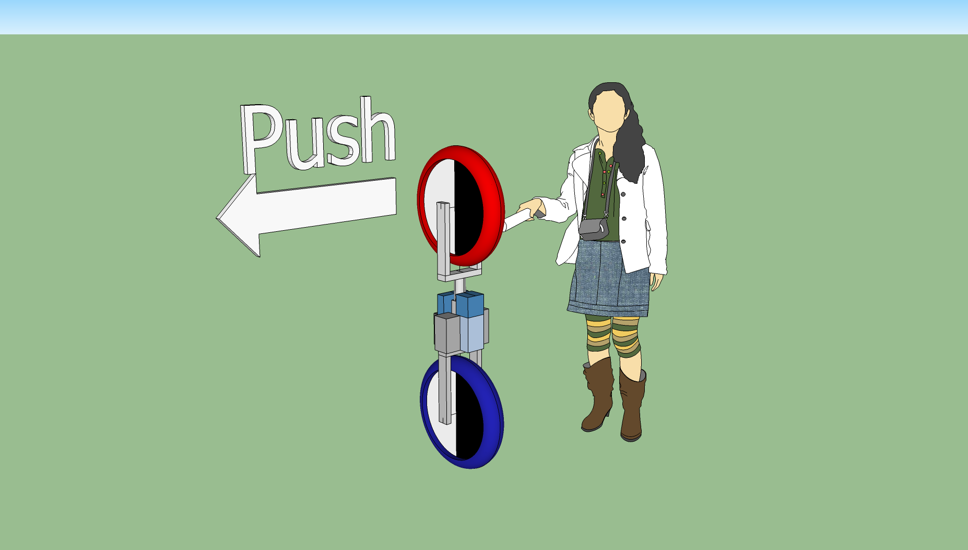
Problem Description
Project Plan
Current Status
Control Strategies
Conclusion
Modeling - Proposed Balancing Mechanism
Notes:
Ruffin

Slide 19
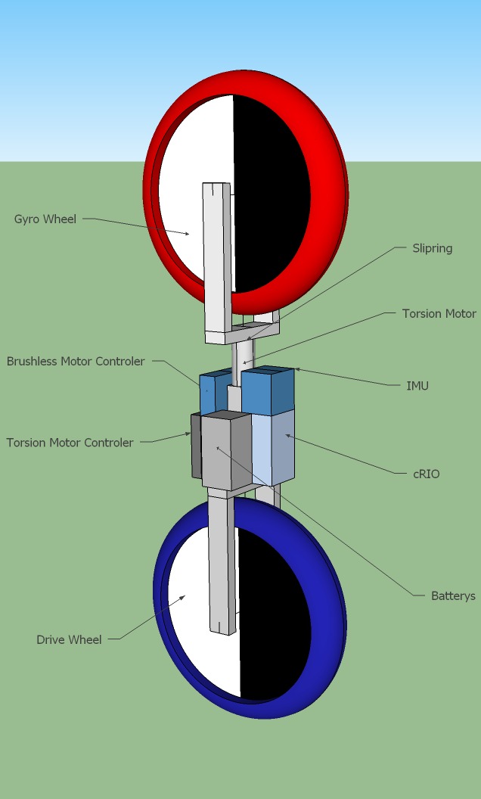
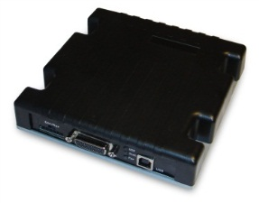

Problem Description
Project Plan
Current Status
Control Strategies
Conclusion
Modeling - Part Locations
Notes:
Ruffin

Slide 20
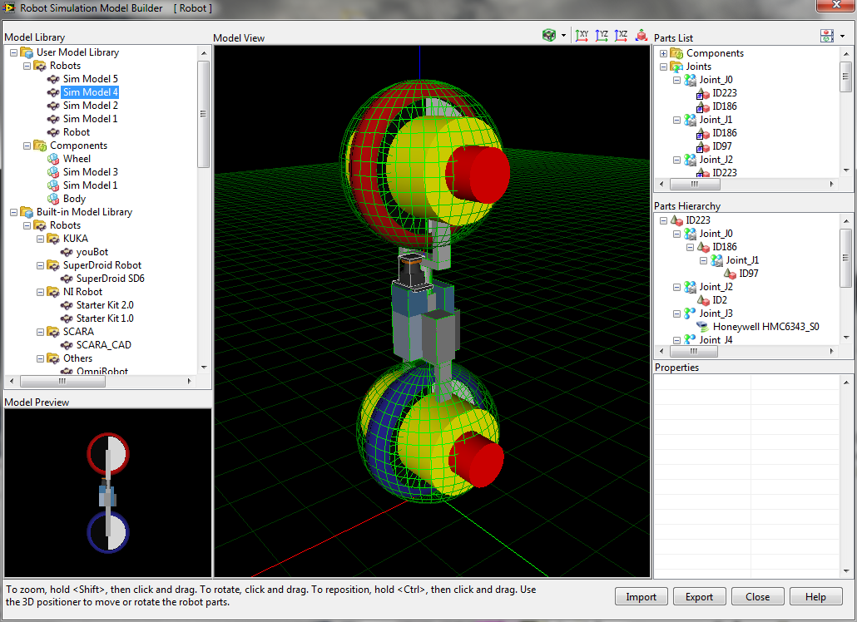
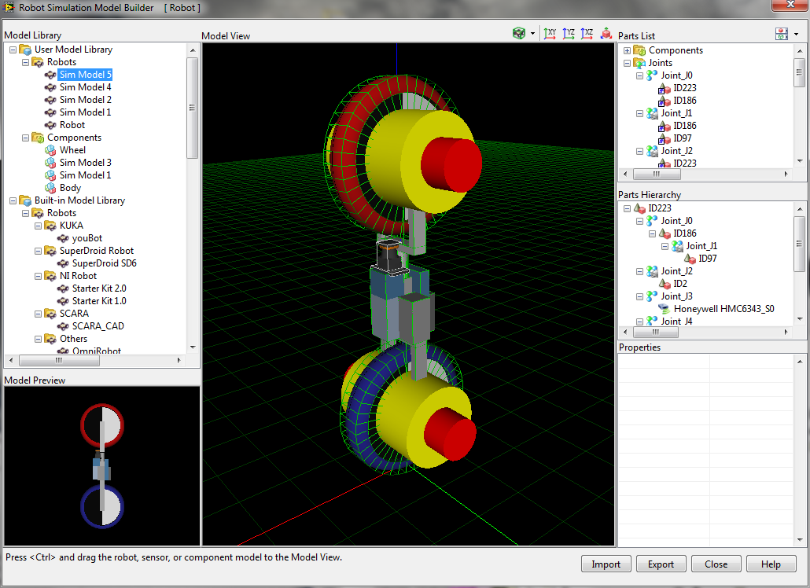
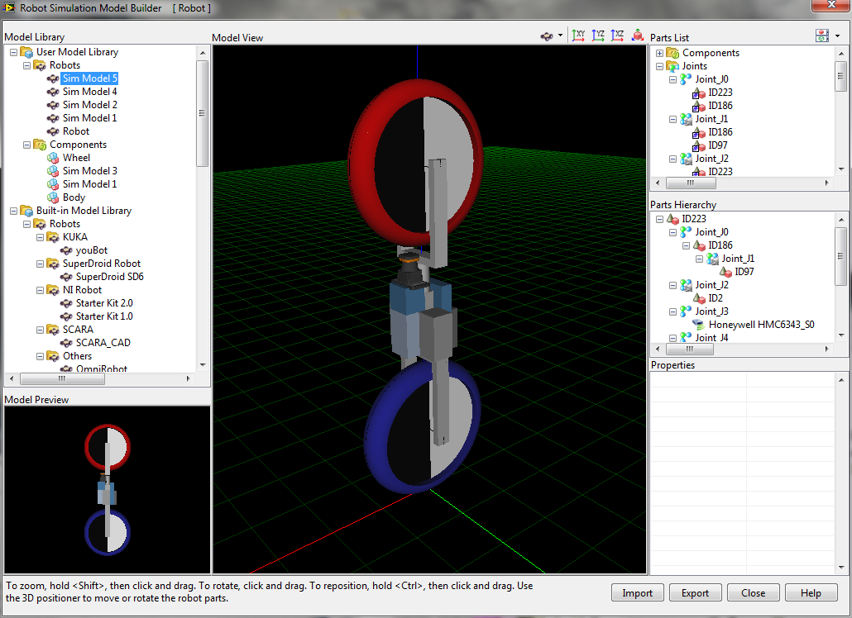
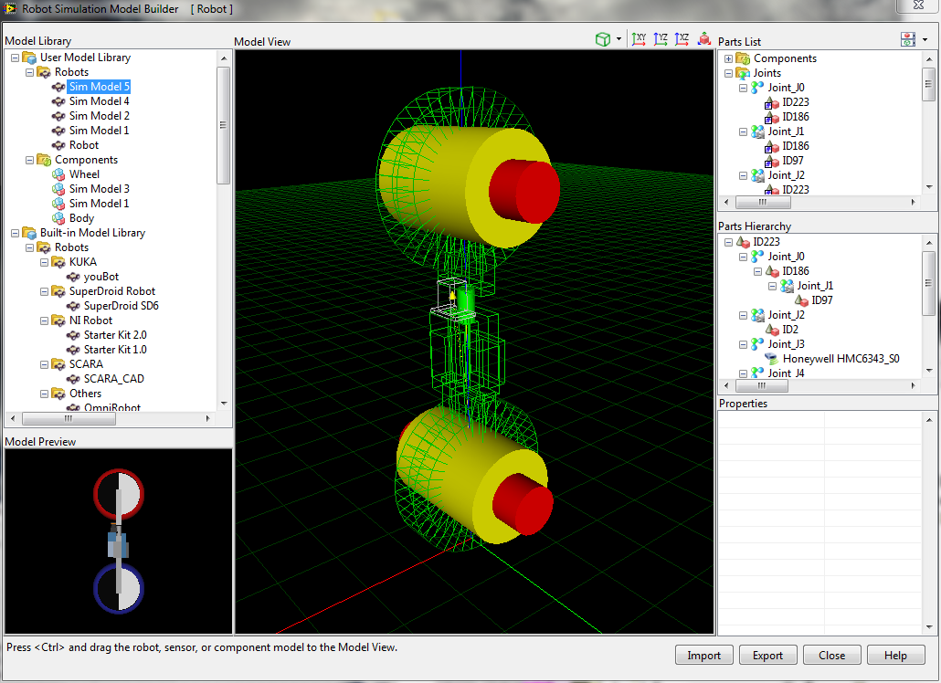
Problem Description
Project Plan
Current Status
Control Strategies
Conclusion
Modeling– Simulation
Notes:
Ruffin

Slide 21
Problem Description
Solution A
Solution B
Solution C
Solution D
Conclusion - Questions
Notes:
Kevin

Slide 22
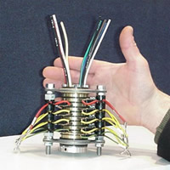
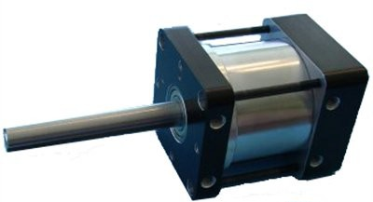
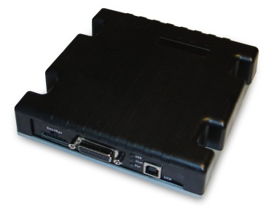
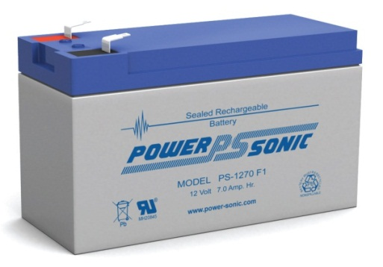
Notes:
Add a legend/number representation for all compenents!

